Slide 1

University of Asia Pacific
Project: AIR TICKET MANAGEMENT SYSTEM

Slide 2
Introduction
Group No: 09
F.M Hadiur Rahman ID:13101060
Taqi Tahmid Tanzil ID:13101065
Tanvir Ahmed ID:13101066

Slide 3
Project purpose
About Reservation of aero plane ticket
Reducing passenger harassment
Proper statics
Passenger care

Slide 4
Project Detail
Keep the aero plane company’s data in a text file
Keep the plane schedules in another text file
Keep the seat capacity in text file
Book or reserve a seat
Reduce the number of passenger capacity
Increase the passenger number in particular plane
Save the passenger list in another text file

Slide 5

Technical matters
Language : C++
Compiler : Code Blocks
System : File System, Data Structure
Header files :<cstdio>,<cstring>,<cstdlib>,<iostream>

Slide 6
Flow Chart
Create text file
Read data from text file
Give output
Declare structure

Slide 7
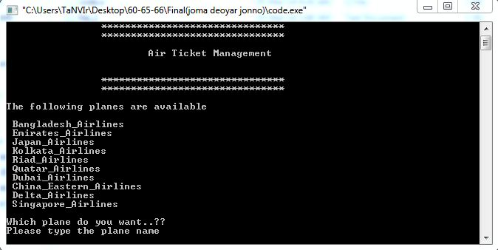
Screenshot

Slide 8
Conclusion
We hope that our project will beneficial for passengers and it will help them to reserve a plane ticket easily. It will also help the companies to keep info about their flights.

Slide 9
Graphics Project
We make an umbrella which will open and close

Slide 10
Thank You
Questions?

